Slide 1
The Chesapeake Digital Preservation Group
Mary Jo Lazun
Head of Collection Management
Maryland State Law Library
Gail Warren
Director
Virginia State Law Library

Slide 2
Chesapeake Project
Began in 2007 as a two-year pilot digital preservation program
  Maryland State Law Library
  Virginia State Law Library
  Georgetown University Law Library
  Harvard University Law Library (joined in 2011)
Established to preserve and ensure permanent access to born-online legal information
Under the auspices of LIPA

Slide 3


Slide 4
Reality check
No desire to collect web sites
No need to collect every publication
Need to find the gold nuggets, the gems, the potentially critical publications

Slide 5

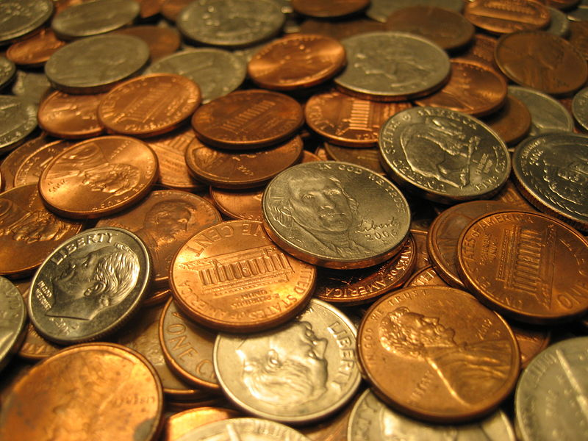
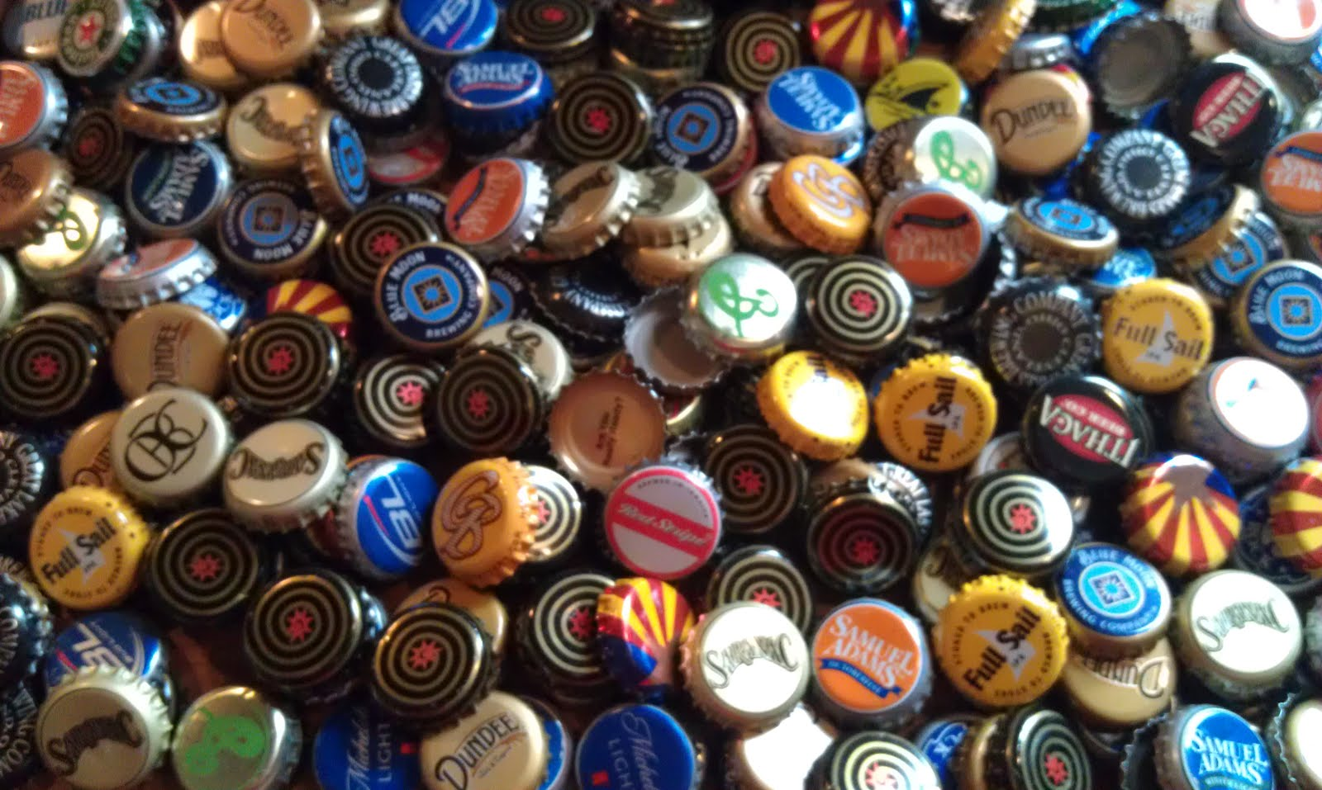
What to collect?

Slide 6
What we collect
Georgetown: Reports and studies relating to U.S. government and policy
Virginia: Publications issued by Virginia's judicial branch of government
Harvard: Legal blogs
Maryland: Materials relating to public policy and legal issues in the state of Maryland

Slide 7
@MSLL we collect
Foundational Publications
Transactional Materials
Mandated Publications
Official Reports
Administrative Materials
Complied Data and Analysis
Directory Information
Ephemeral Publications
Current Information for Public

Slide 8
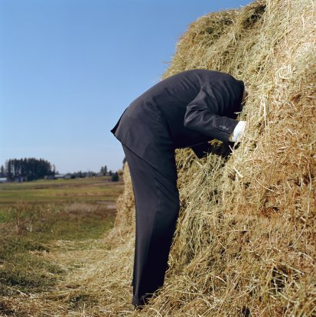
Challenging to locate materials

Slide 9
Where we find publications
Suggestions from librarians
News sources-Google Alerts
Track web sites: Watch that Page
Claim reports from our ILS’s
Collection reports — Maryland Documents and the Maryland Clipper
RSS Feeds--State Publications Depository & Distribution Program

Slide 10
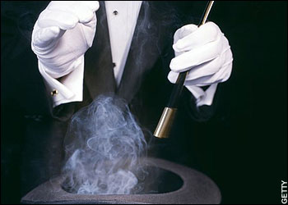
Why we collect

Slide 11
Disappearing publications
50%

Slide 12
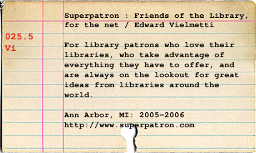
The Process:
Catalog the item

Slide 13
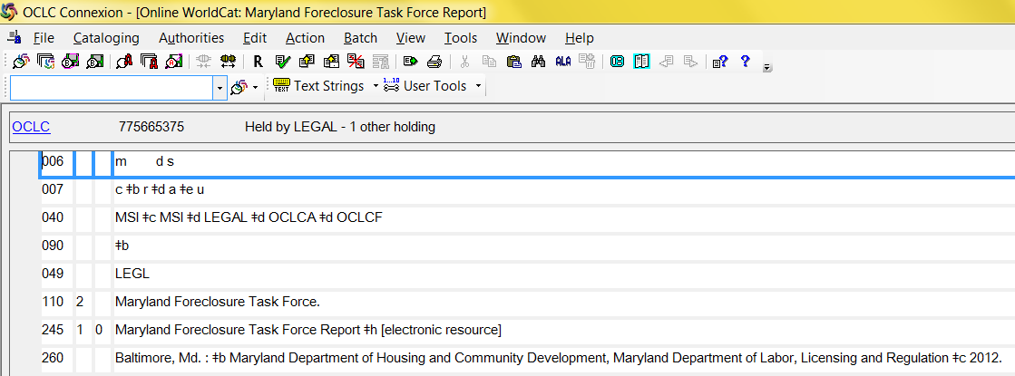
The Process:
Catalog the item via OCLC

Slide 14
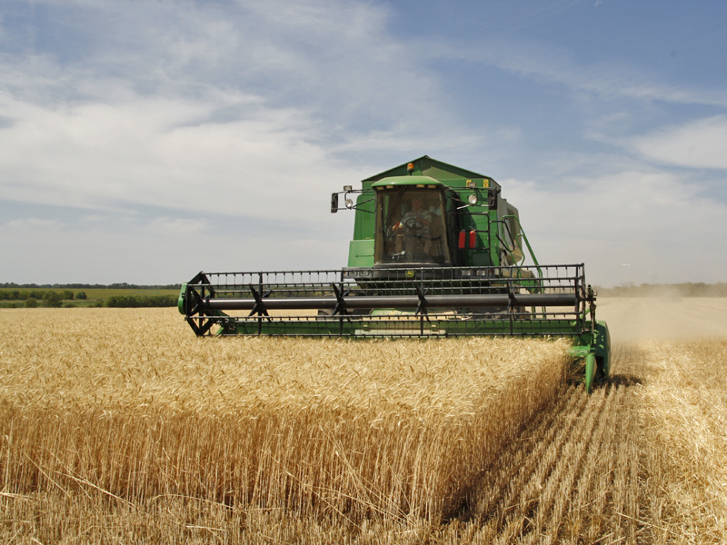
The Process:
Harvest the item

Slide 15
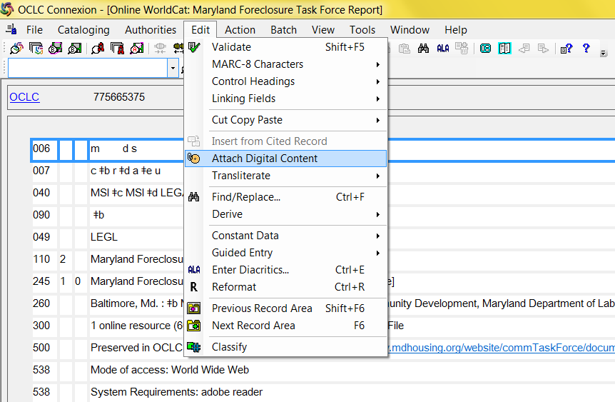
The Process:
Harvest via Connexion Client

Slide 16

The Process:
Add Metadata

Slide 17
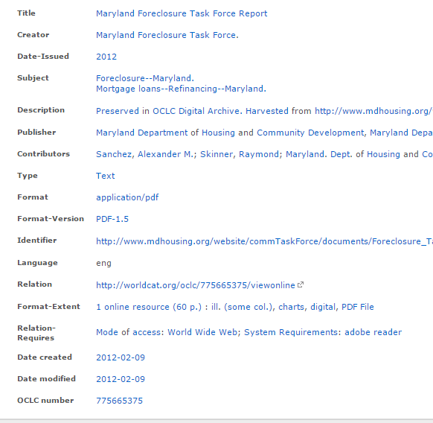
The Process:
Add Metadata in CONTENTdm
MARC to Dublin Core
Add original URL and date harvested
PDF version

Slide 18
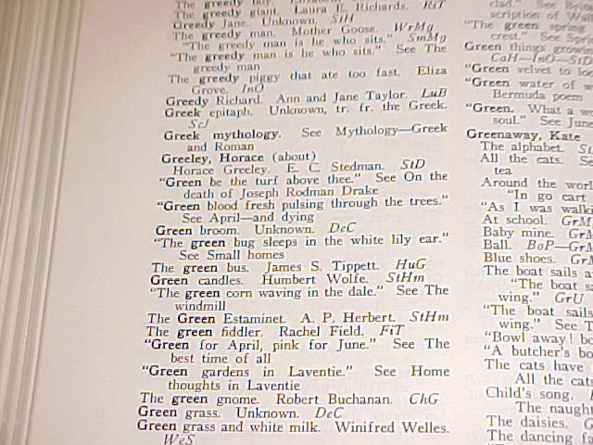
The Process:
Index Material

Slide 19
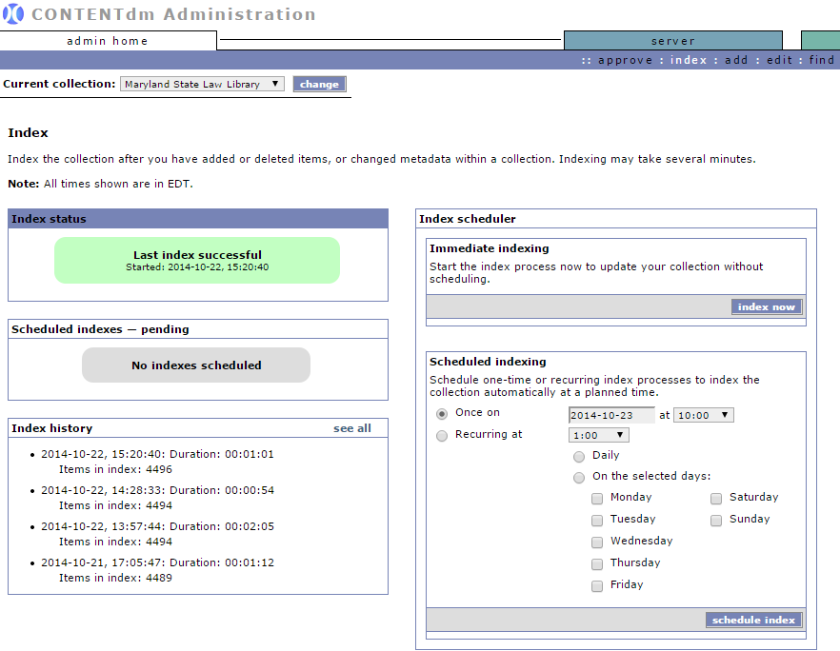
The Process:
Index in CONTENTdm

Slide 20
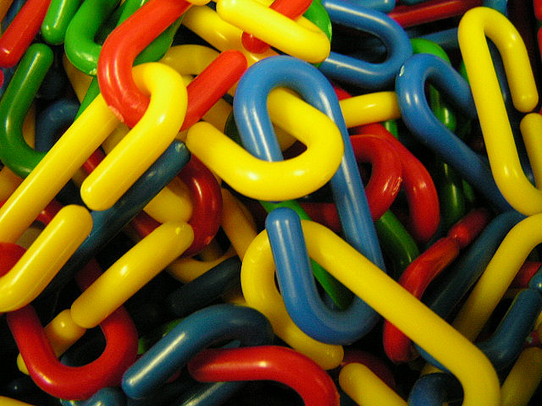
The Process:
Add links to our catalogs

Slide 21
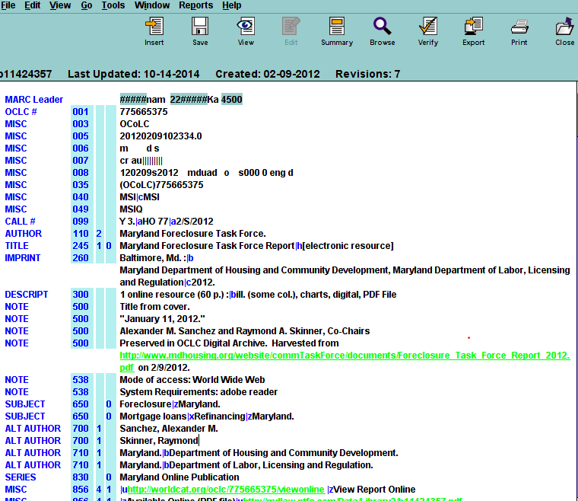
The Process:
Add 856 links

Slide 22
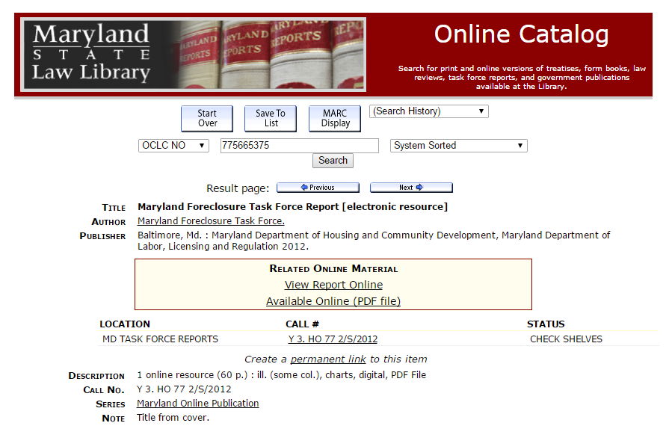
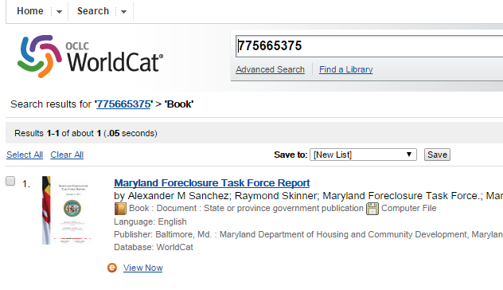
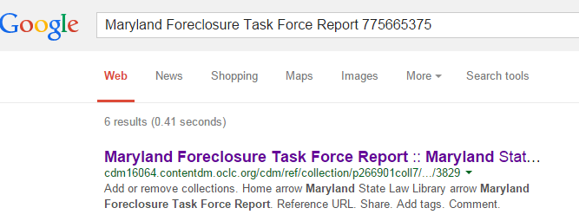
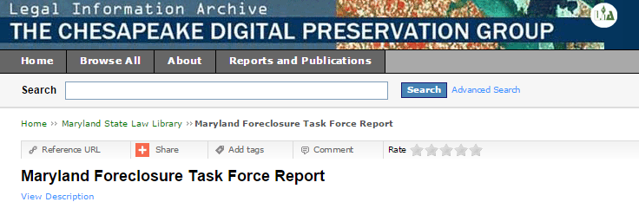
Now available

