Slide 1
Future of Law Libraries, LIPA and Chesapeake, Oh My!
October 28, 2014
Law Library Association of Maryland
Gail Warren
State Law Librarian
Virginia State Law Library

Slide 2
Beyond the Boundaries
Report of the AALL Special Committee on the Future of Law Libraries in the Digital Age, released July 2002
  Visualize the future
  Consider “possible as-yet-to-be-discovered” scenarios
  Access at AALLNET:
    http://www.aallnet.org/Archived/Leadership-Governance/committees/final-report-including-appendices.pdf

Slide 3
Trends Considered:
Commercial Legal Publishing
Access to Information
Preservation and Permanence**
Authentication of Online Resources

Slide 4
More:
Intellectual Property, Licensing and Technological Controls
User Expectations
Technology

Slide 5

Creating scenarios??

Slide 6
Envisioned Roles
Creating Virtual Law Libraries
Redefining Traditional Roles
External Collaborations and Expanding Staffing Roles
Establishing Repository Libraries and Library Consortia

Slide 7

What we got right?

Slide 8
Checklist …
Importance of collaboration
Continuing role for library as place
Increasing reliance on electronic resources
Access vs. ownership
Continuing need for archival print repositories
Consolidation of library services
Increasing role for librarian as teacher

Slide 9

What we missed?

Slide 10
Everything E-Government: federal, state, local
Shifting from singular focus on access and licensing of proprietary information to multiple focus, including preservation of federal and state government information
Expanding role of law libraries in the preservation of born-digital and digitized legal information

Slide 11

Bob Oakley’s vision …

Slide 12
March 2003
“Preserving Legal Information for the 21st Century: Toward a National Agenda”
  Georgetown University Law Library
  American Association of Law Libraries
Outcome? An organization that would provide a framework for creating solutions to the problems of preserving legal information.

Slide 13
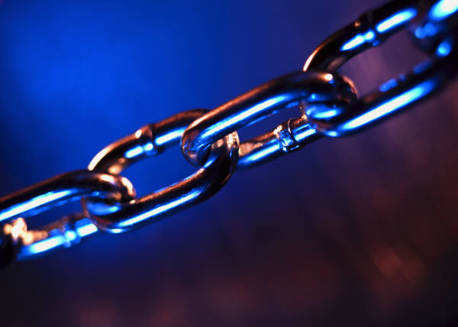

Slide 14
Legal Information Preservation Alliance
Preserving Legal Materials In Digital Formats , a white paper issued in 2005 (available on the LIPA web site)
Chesapeake Digital Preservation Project implemented as a two-year pilot in 2007
Going Forward??

