Slide 1

In a World They Know:
Using Google to Serve Public Patrons
Joanne Dugan Colvin
LLAM Legal Research Institute
Access to Justice
March 21, 2014

Slide 2
Frequent Challenges with Public Patrons:
How Sophisticated is Your Patron?
  Often very basic online search skills
  Little familiarity with law
Limited amount of time to spend in the law library
  “public” versions of commercial databases rarely available outside the library

Slide 3
Using Google to Start Legal Research
Secondary research
  Library research guides
  Government websites
  Organization websites
  Specialty law firm websites
  Independent websites
Notes:
Hypothetical: patron wants to find out if he can be evicted based solely on the fact that he owns a pit bull.
Google search: pit bulls Maryland

Slide 4
Google Scholar for Cases
Coverage
  State caselaw from 1950
  Federal caselaw from 1923
  U.S. Supreme Court from 1791
How It Works:
  http://www.youtube.com/watch?v=UGDJTeabQzU

Slide 5
Google Scholar for Cases
Significant Limitations
  No citator (except “How cited”)
  Few fields/segments to limit your search
  No links to cited sources (statutes, etc.) unless they are already in the Google database

Slide 6
A Little Knowledge is a Powerful Thing
Emphasize:
  How Google can help you:
    Become familiar with an area of law
    Terms of art – will suggest/substitute similar words
    Leading cases

Slide 7
A Little Knowledge is a Dangerous Thing
Emphasize:
  Warnings:
    Limitations of caselaw
      Currency
      Jurisdiction and authority
    Relation of other forms of law to caselaw
      Rock, paper, scissors

Slide 8
How to Evaluate a Website
Authority
  Is the author identified? Contact info provided?
  What are the author’s credentials?
  Is there a comparable print version?
Accuracy
  References supporting the facts presented
  Obvious errors in grammar and spelling
  Is it cited by other websites/resources?
Notes:
http://www.rythospital.com/2011/
RYT Hospital at Dwayne Medical Center: male pregnancy; no sleep, head transplants.
Dihydrogen Monoxide Research Division
http://www.dhmo.org/
Accuracy:
Don’t over-rely on placement in search results – you can pay for that.

Slide 9
How to Evaluate a Website
Objectivity
  Obvious bias/advocacy
    Are opinions clearly distinguished from factual content?
  What is the domain?
    .edu, .gov, .org, .com, .net
  Example: gatt.org vs. WTO.org
Currentness
  Does it say when the site was last updated?
  Are there a lot of dead links?
Notes:
What info is included and what is deliberately left out?
“Honest” bias may be indicated in about us / sponsors / biography / Background
What sites link to or are link to by this site?
Check the blog roll.

Slide 10
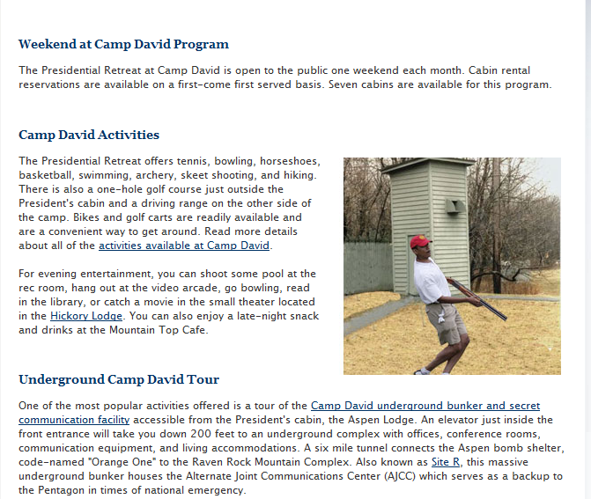
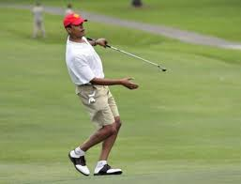
Don’t Be Fooled
Notes:
Many instances where someone (usually a foreign country) reports a spoof (usually The Onion) as real news.
Chinese media reported Onion spoof “Kim Jong Un “sexiest man alive.”
China’s People’s Daily Online carried the Onion’s story “North Korea’s Kim Jong Un the “sexiest man alive for 2012.”
More seriously: Websites providing inaccurate, outdated, incomplete information – regardless of the owner’s intent.
National Review and Camp David/skeet-shooting spoof. (National Review tweeted the picture before noticing that the URL was .gov1, not .gov.)

Slide 11
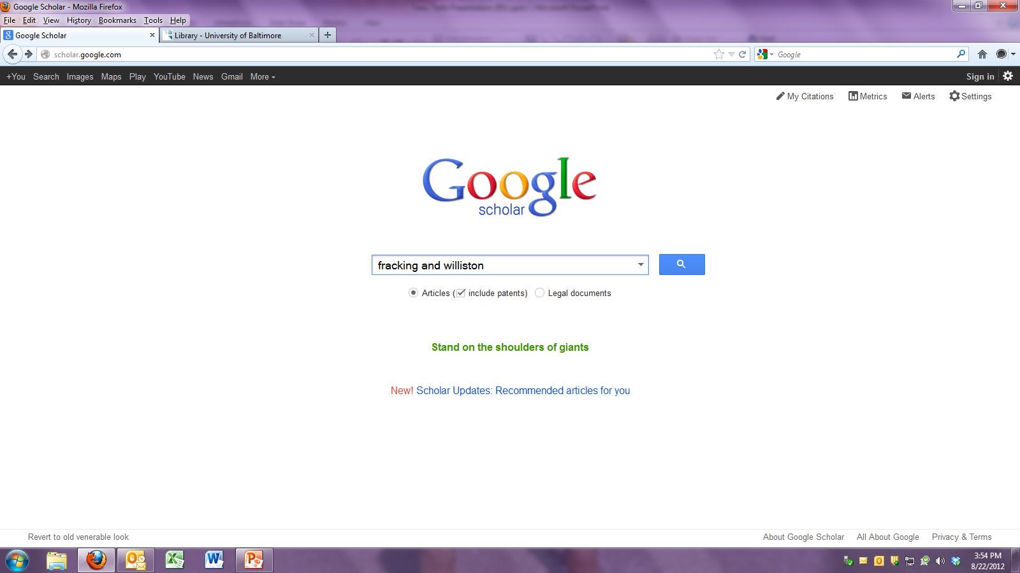
Searches articles, books, theses, etc. from non-commercial sources (academic publishers, professional societies, web resources.)
Includes non-law resources that may not show up in law-specific searches.
Example: fracking and Williston

Slide 12
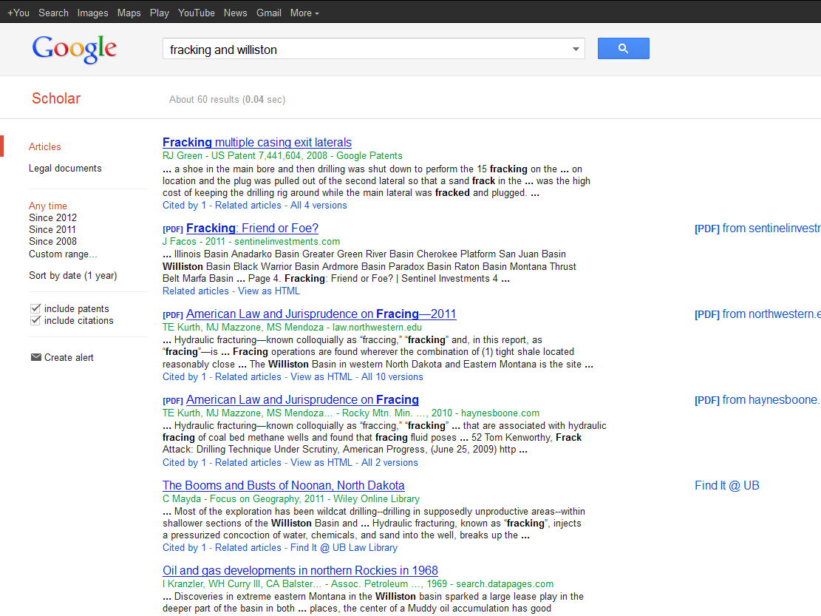

Slide 13
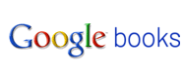
fg
Searchable database of book content no longer in copyright, or with rights-owners’ permission.
Current debate over how to handle works still in copyright, especially “orphan works.”

